Slide 1
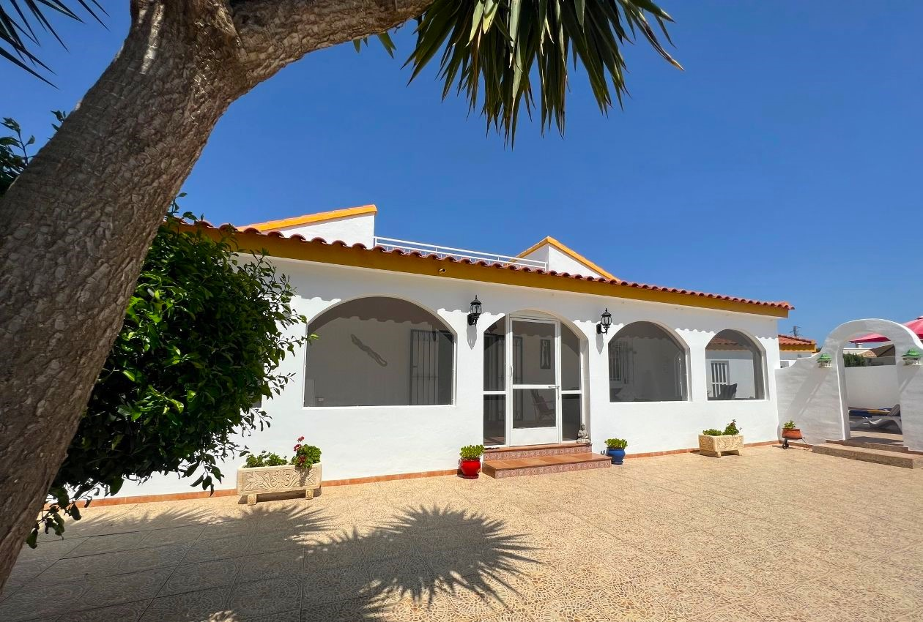
Casa la Cerradilla
The front of the house

Slide 2
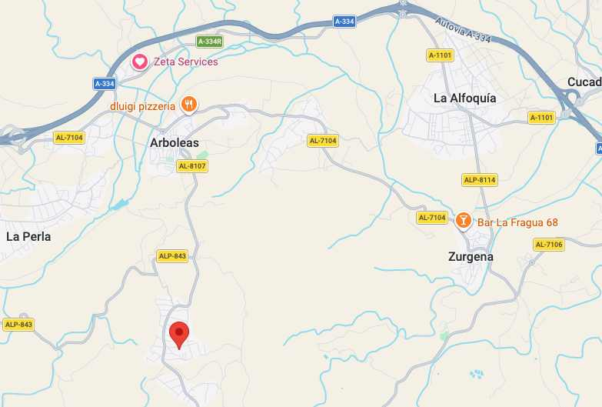
Casa la Cerradilla
Location is red “tear drop”

Slide 3
Casa la Cerradilla, Calle Canario,
Los Carrascos
[It’s Carrascos, not Corroscos]

Slide 4
Casa la Cerradilla, Calle Canario 2, Las Carrascos, Arboleas, Almeria
Annex
A brief introduction
Plan

Slide 5
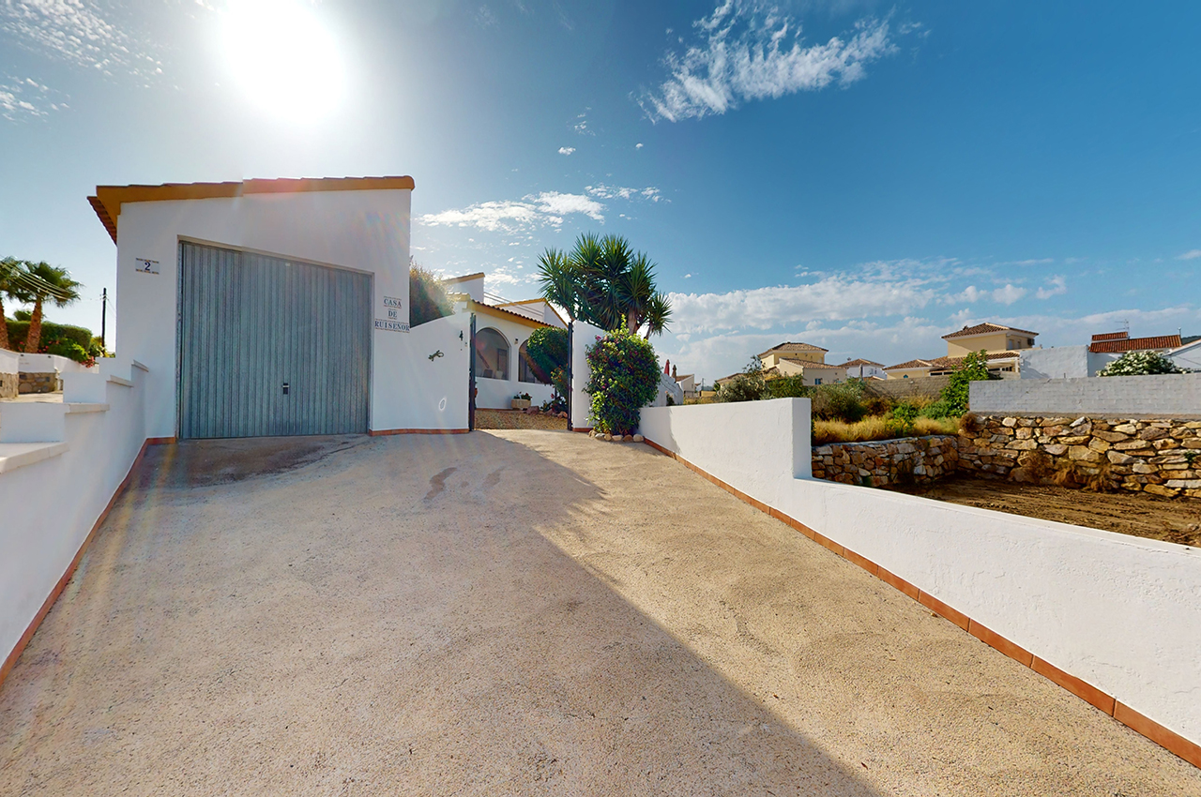
Casa la Cerradilla
The drive and the garage which needs repainting and renaming..

Slide 6
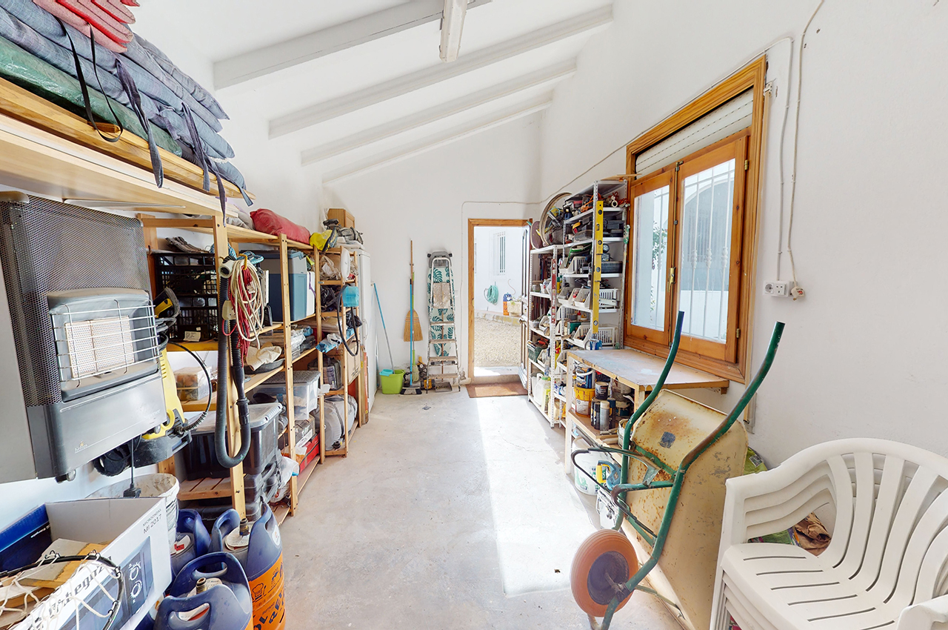
Casa la Cerradilla
Garage shelving - other contents will be changed .

Slide 7
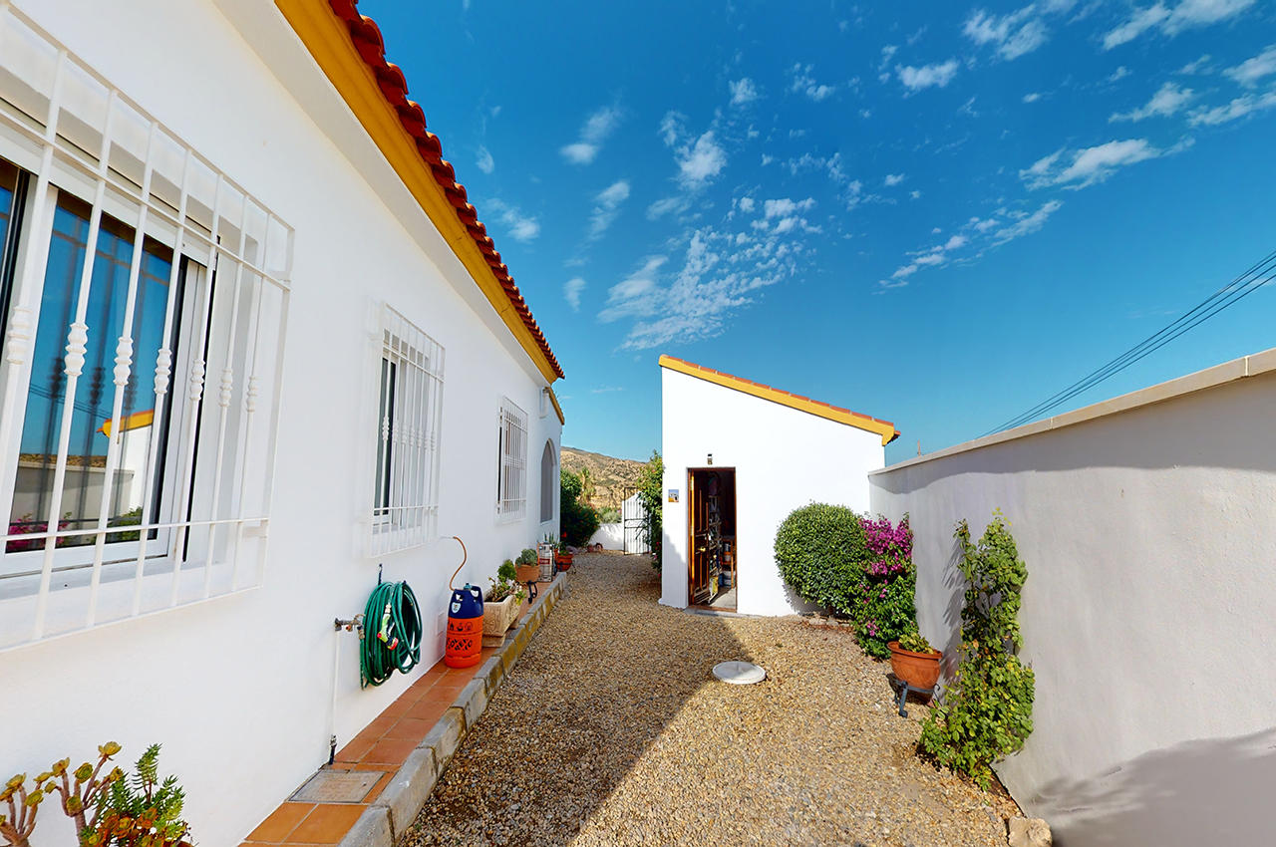
Casa la Cerradilla
Back door to the garage and kitchen side of house

Slide 8
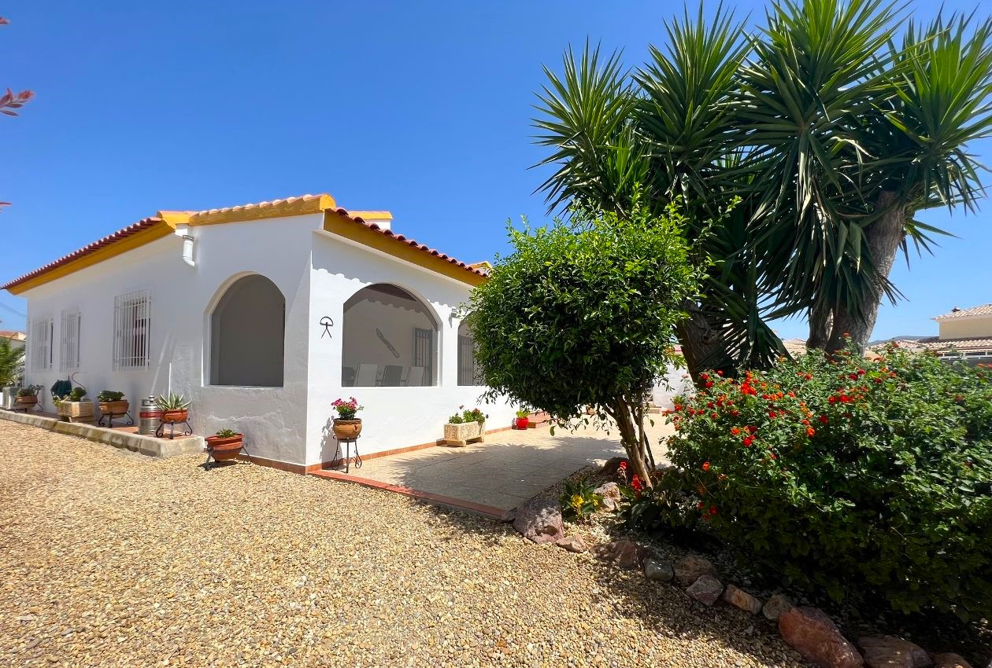
Casa la Cerradilla
View from the gate beside the garage

Slide 9
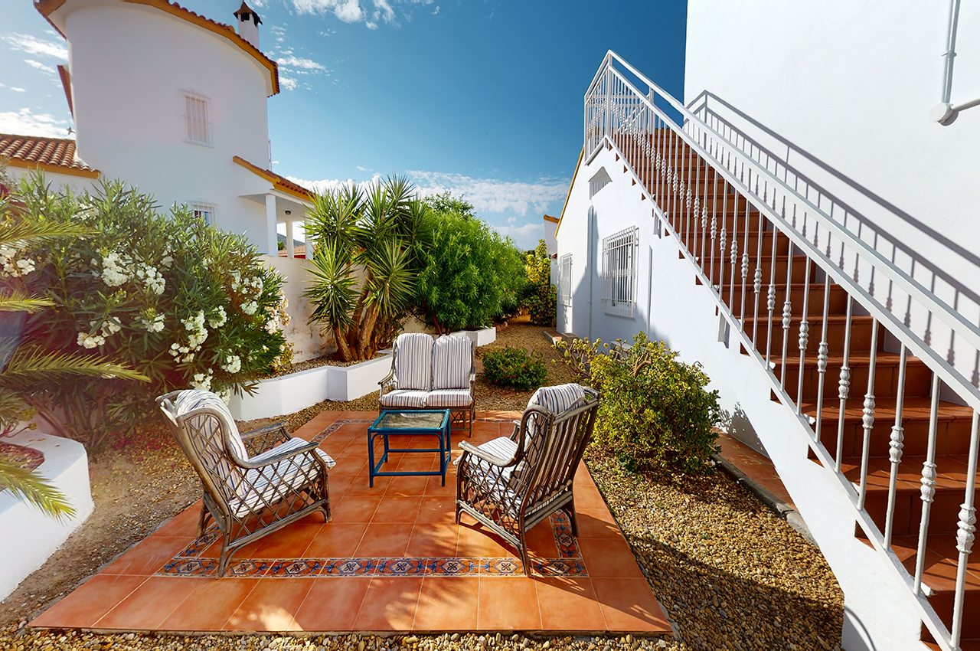
Casa la Cerradilla
The back garden and steps to the roof terrace

Slide 10
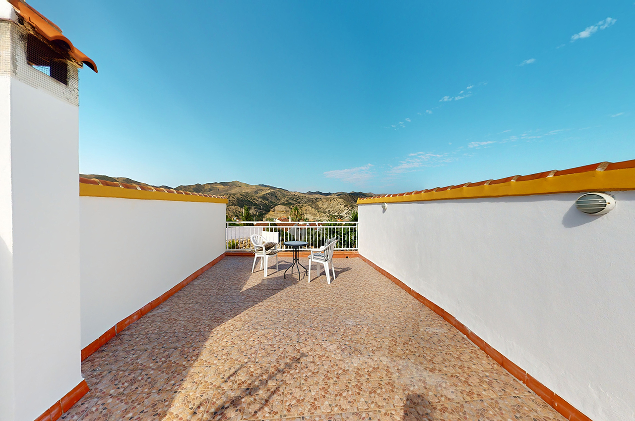
Casa la Cerradilla
The roof terrace with hills behind

Slide 11
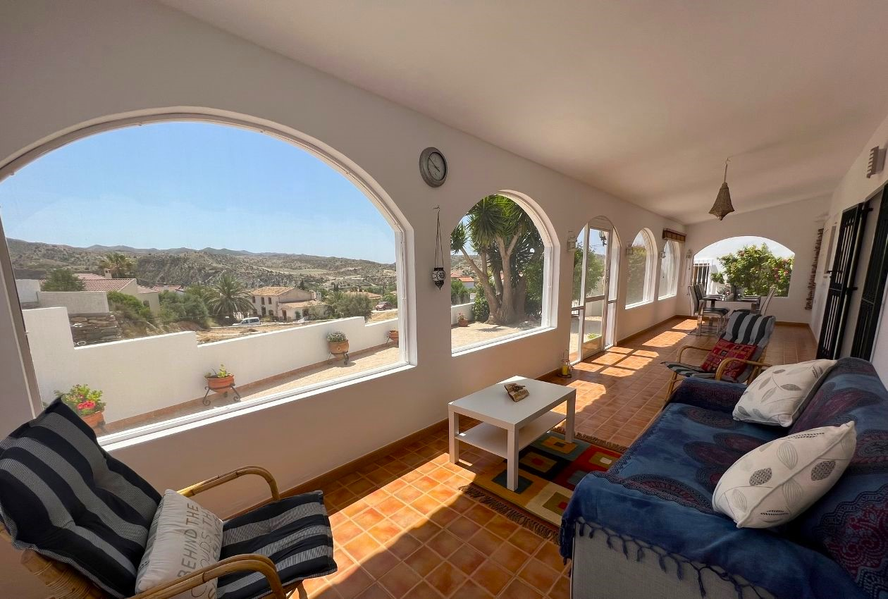
Casa la Cerradilla
The front porch and front garden
(the wall will be heightened and a bungalow is now behind the wall)

Slide 12
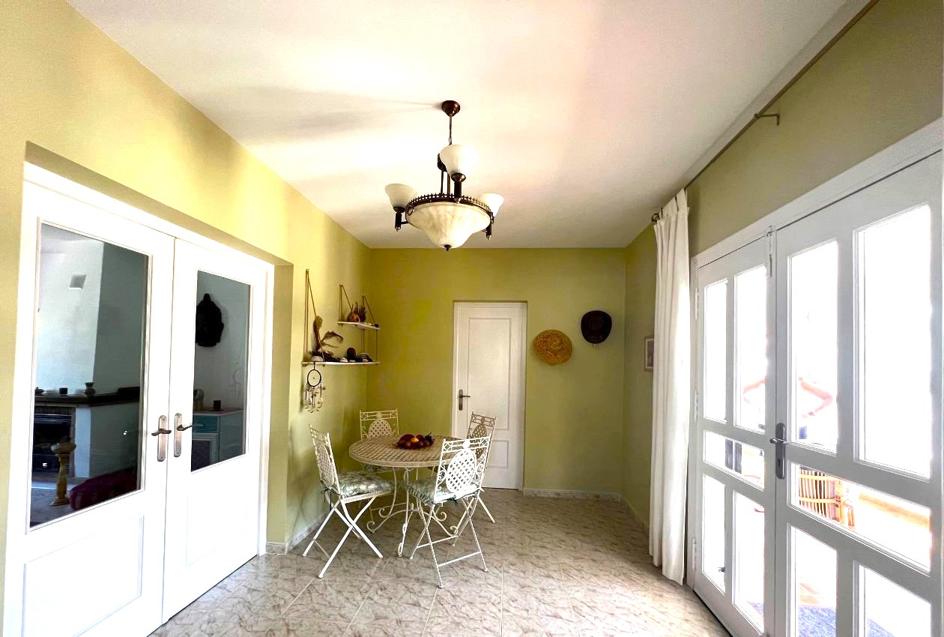
Casa la Cerradilla
The winter dining area and front door
(the study/bedroom 3 door is in middle of the picture)

Slide 13
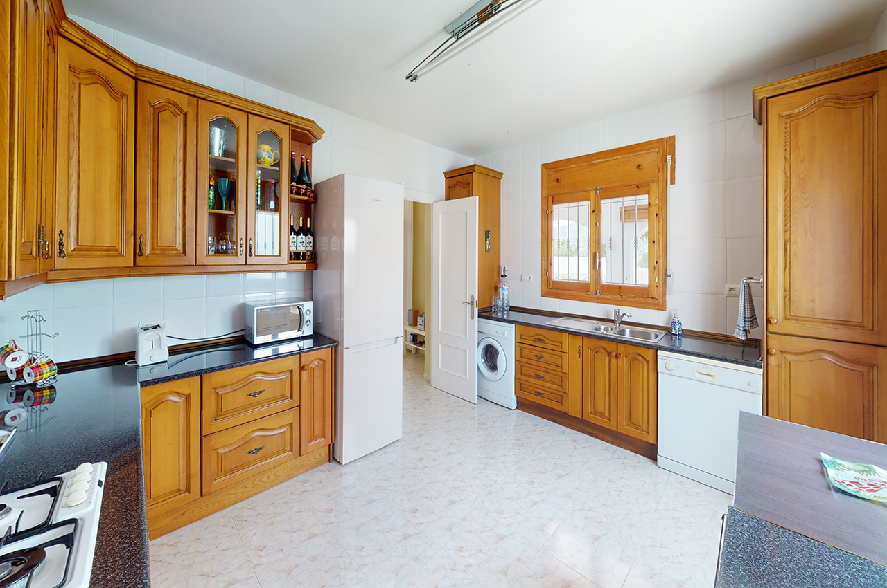
Casa la Cerradilla
Kitchen (Washing area)

Slide 14
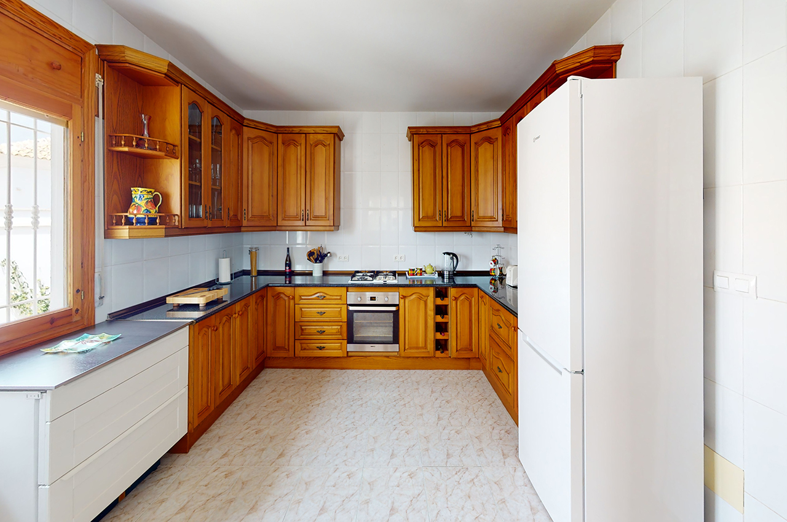
Casa la Cerradilla
Kitchen (Cooking area)
(As 20 years old might need refurnish)

Slide 15
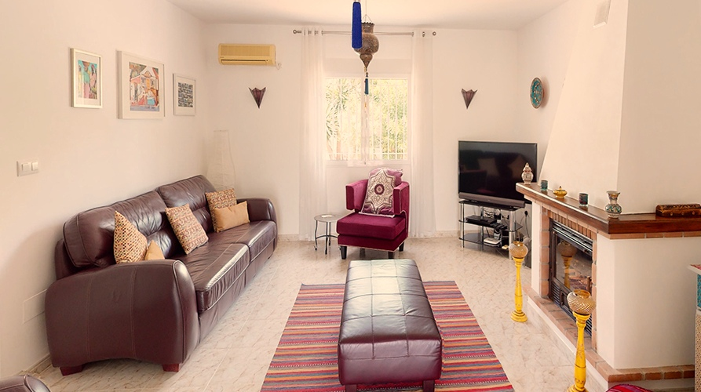
Sitting room
(with main television)

Slide 16
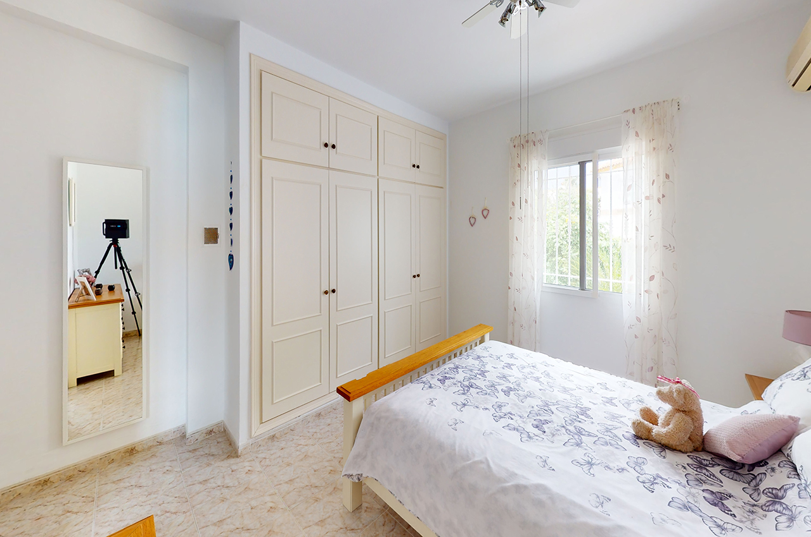
Casa la Cerradilla
Bedroom 1

Slide 17
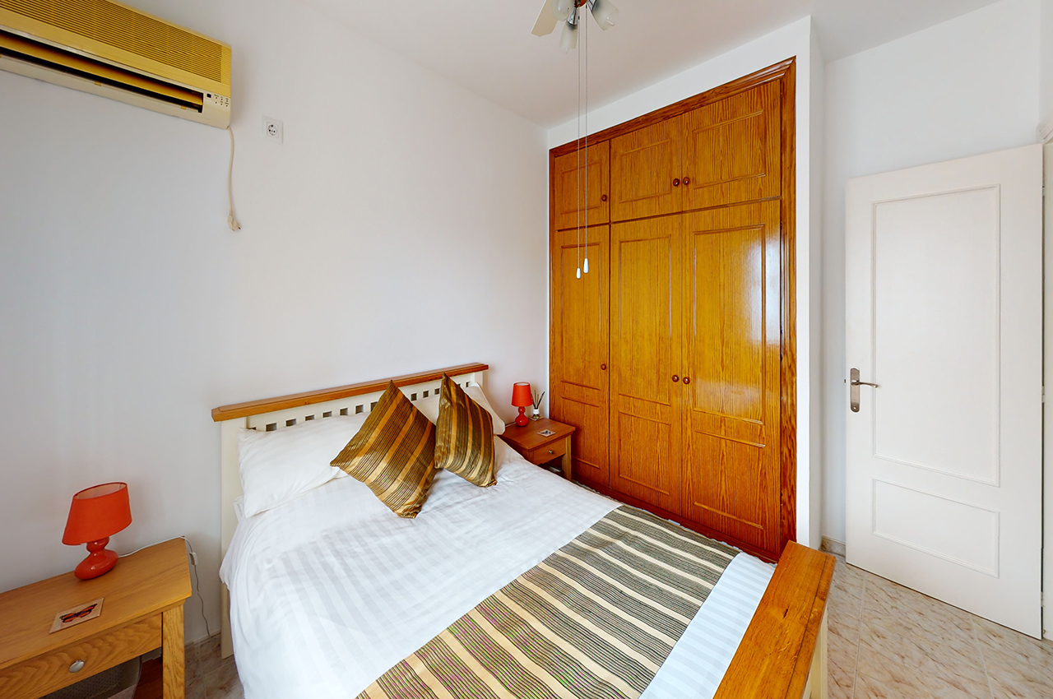
Casa la Cerradilla
Bedroom 2

Slide 18
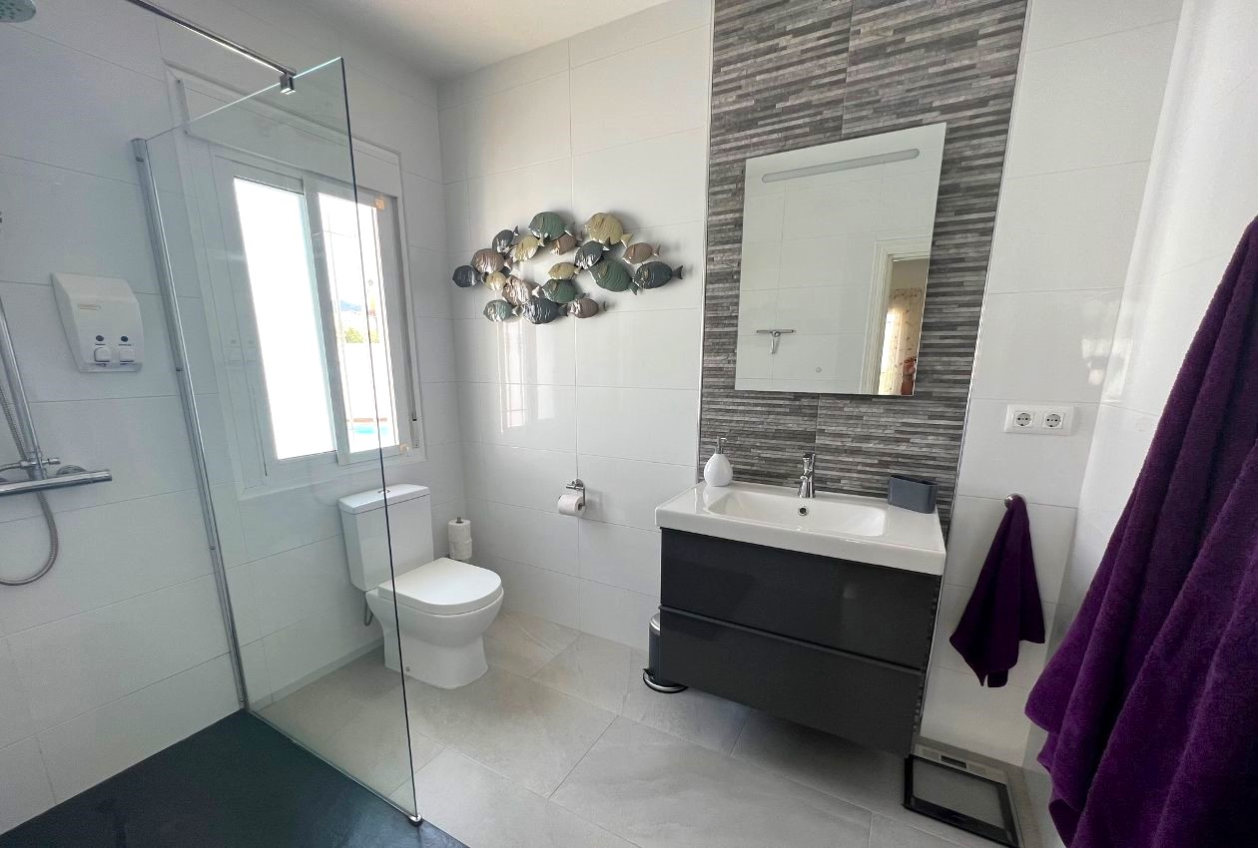
Casa la Cerradilla
One of the shower rooms

Slide 19
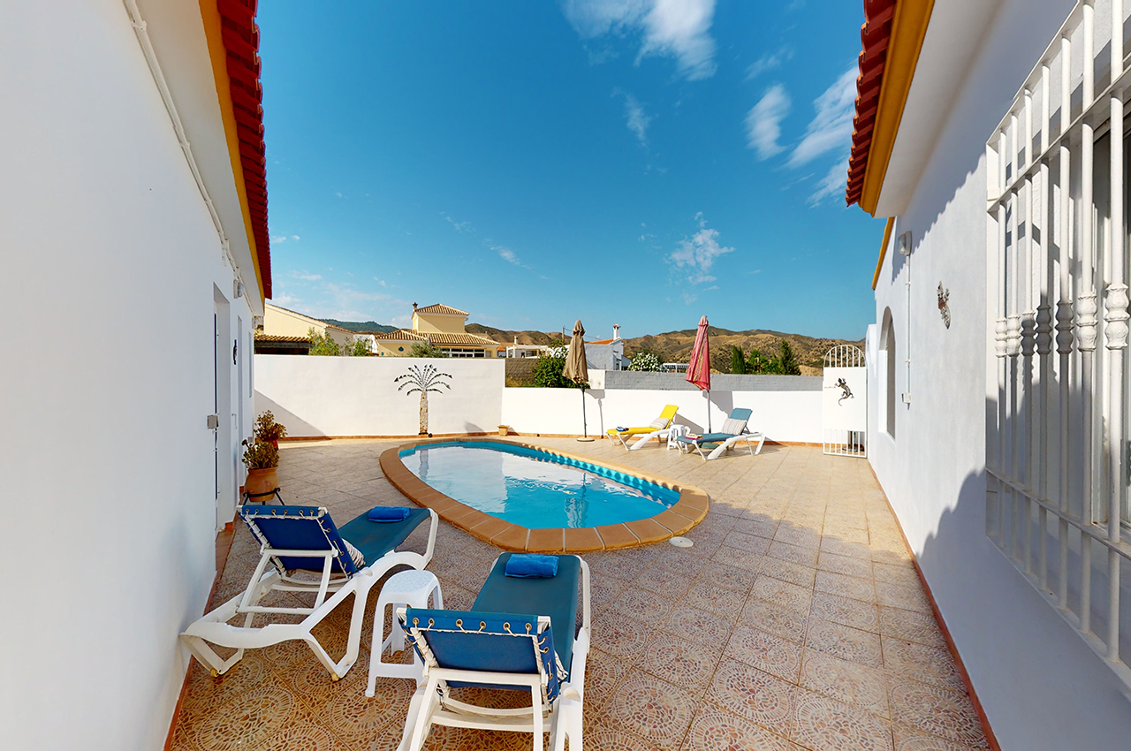
Casa la Cerradilla
Pool with annex to the left

Slide 20
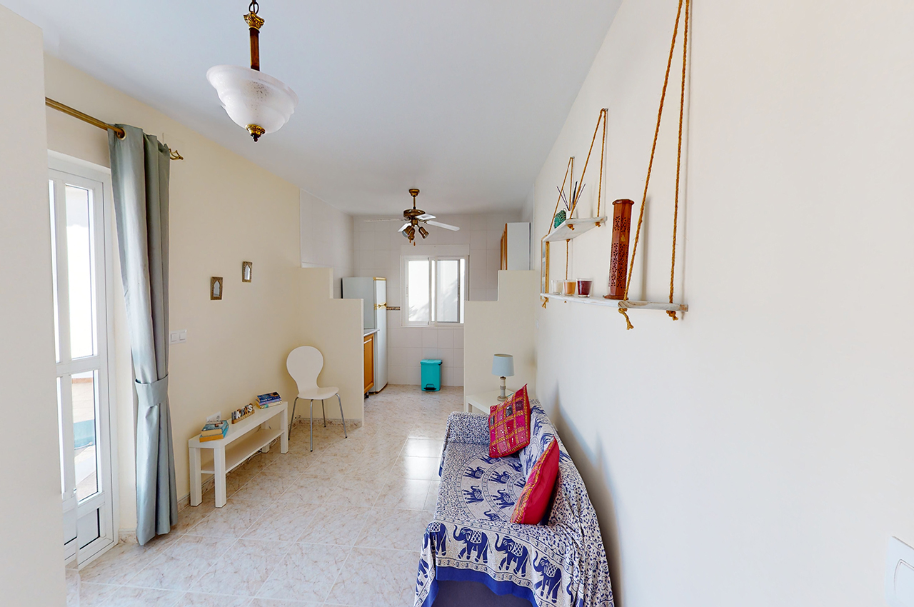
Casa la Cerradilla
Main annex rooms

Slide 21
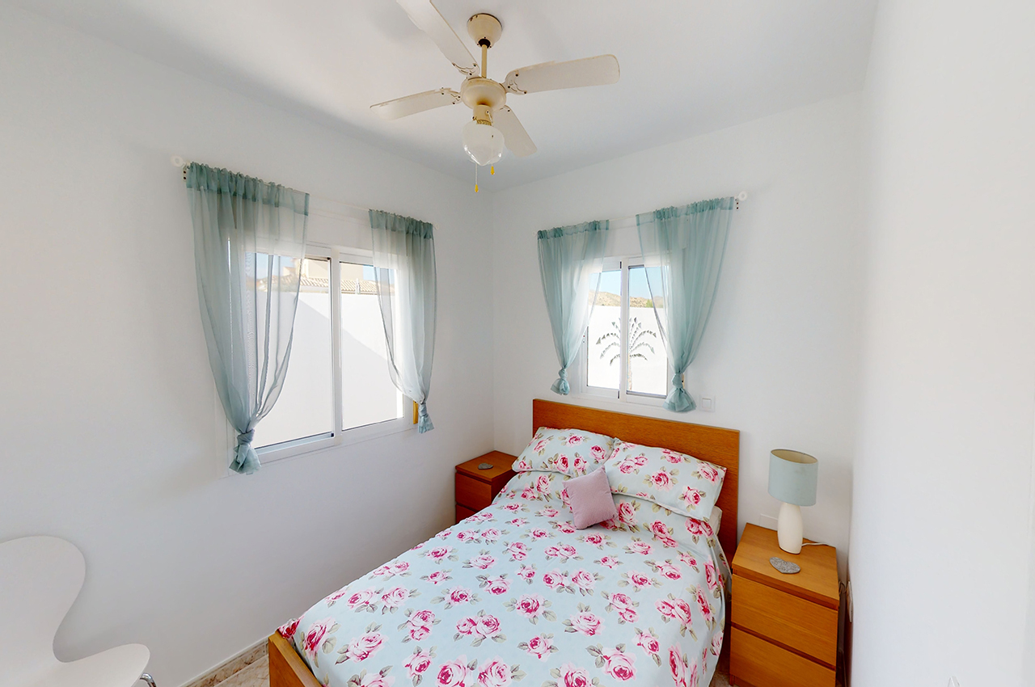
Casa la Cerradilla
Annex bedroom

Slide 22
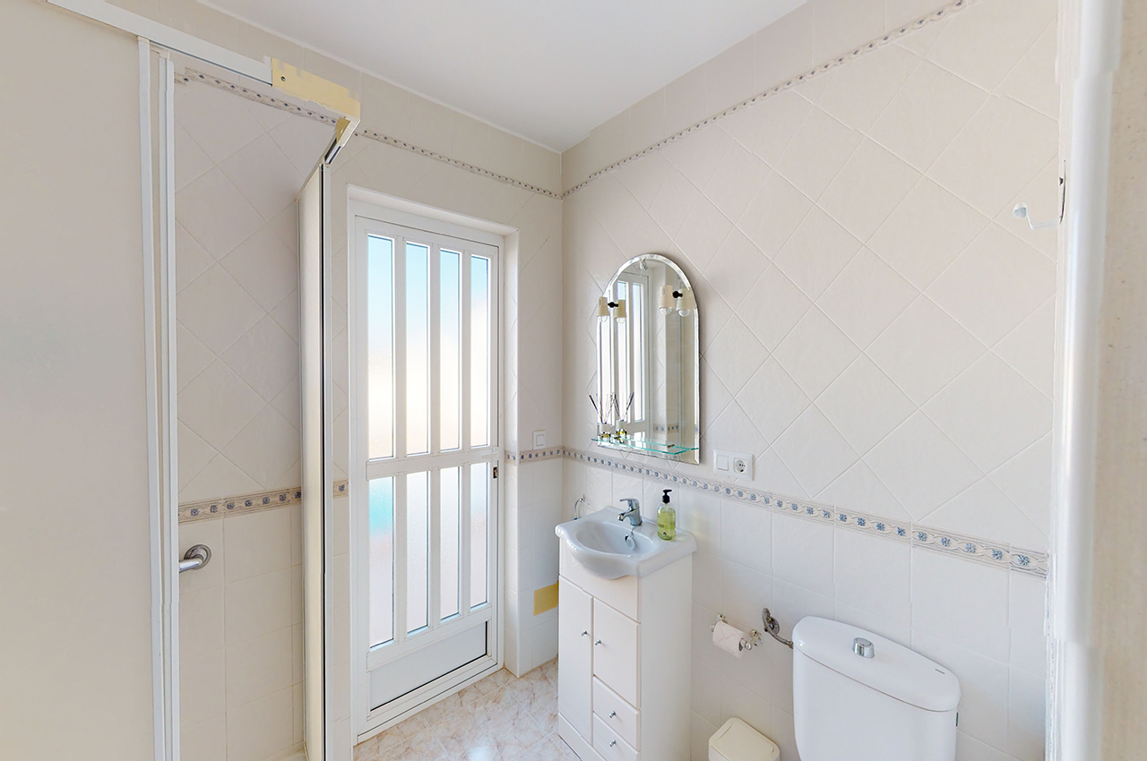
Casa la Cerradilla
Annex shower room
and pool “changing” room

Slide 23
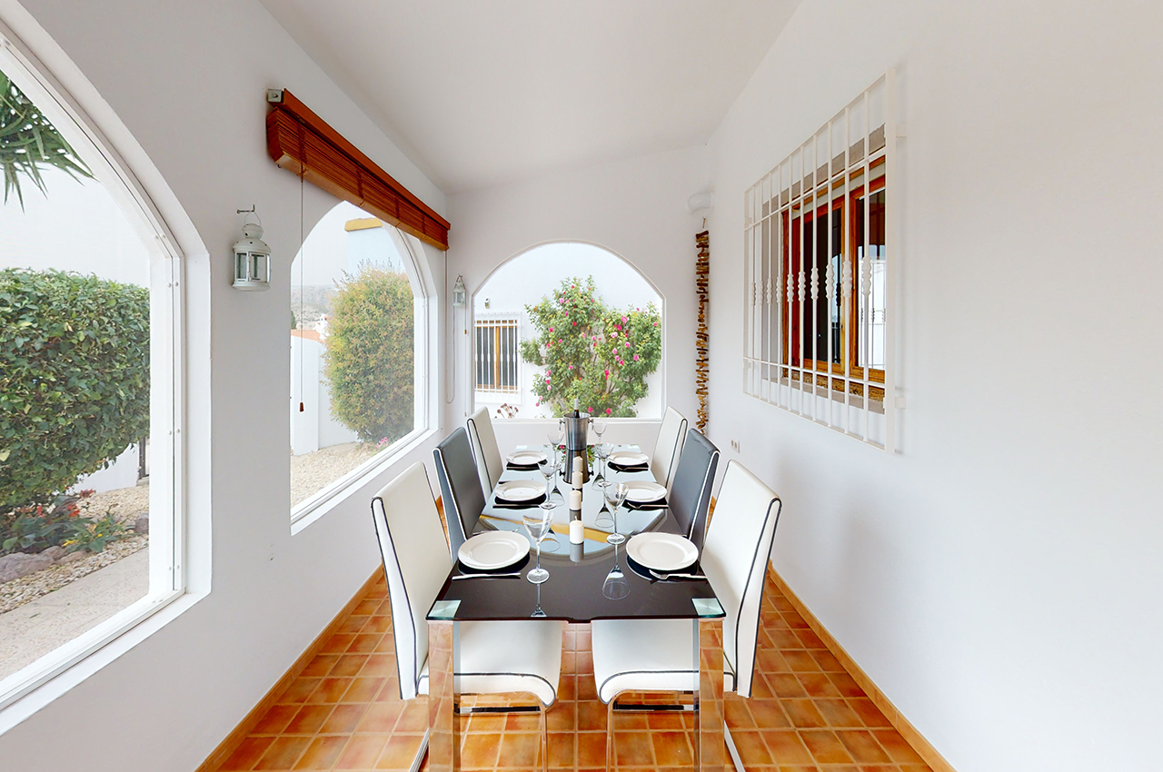
Casa la Cerradilla
Ready to eat???
[End of presentation]

